Slide 1
Predicting Number of Cyclist from NYC DOT Data
Brad Harbans

Slide 2
Summary
The NYC Department of Transportation (NYC DOT) collects a daily total of bike counts conducted monthly on bridges that cross the East River in NYC.
The data is used by the city for transportation planning
The dataset also contains the temperature and precipitation for the days
Two models were built a General Additive Model and a General Linear Model.

Slide 3
Motivation
One would expect that days with extreme temperatures to have lesser bicycle usage.
One would expect that days with precipitation to have lesser bicycle usage.
The target variable is count data, as such a Poisson regression would be a good candidate.

Slide 4
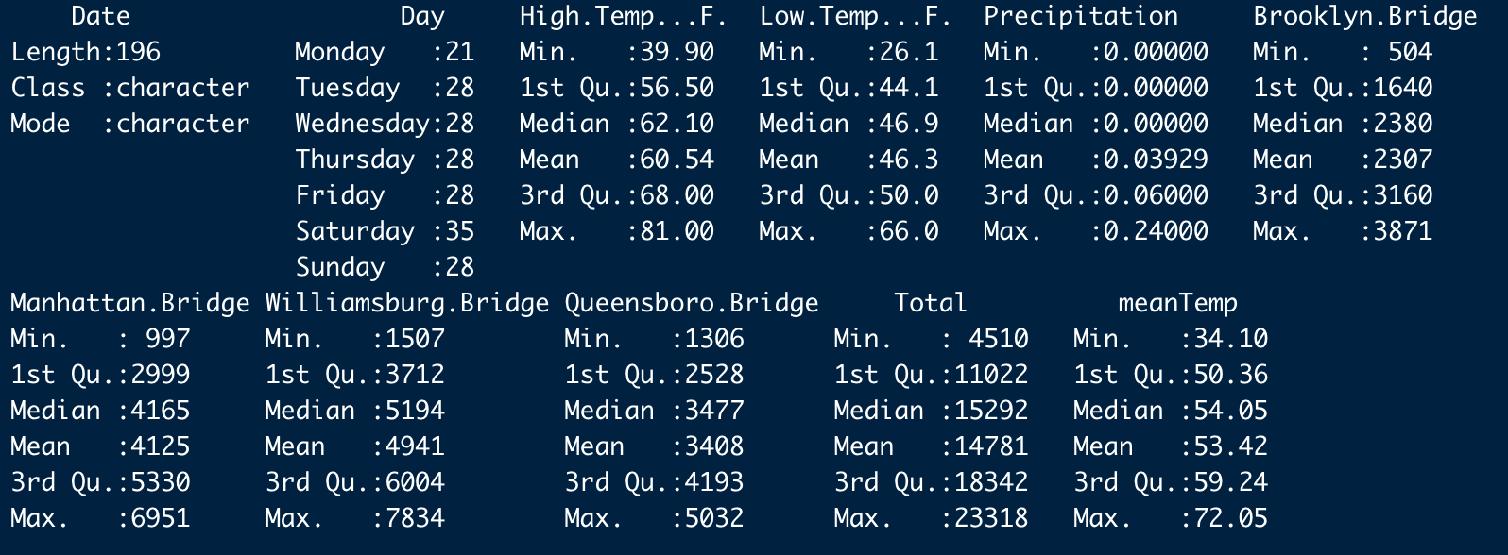
Data Exploration
The dataset is small, consisting of 210 records. With 9 predictors.

Slide 5
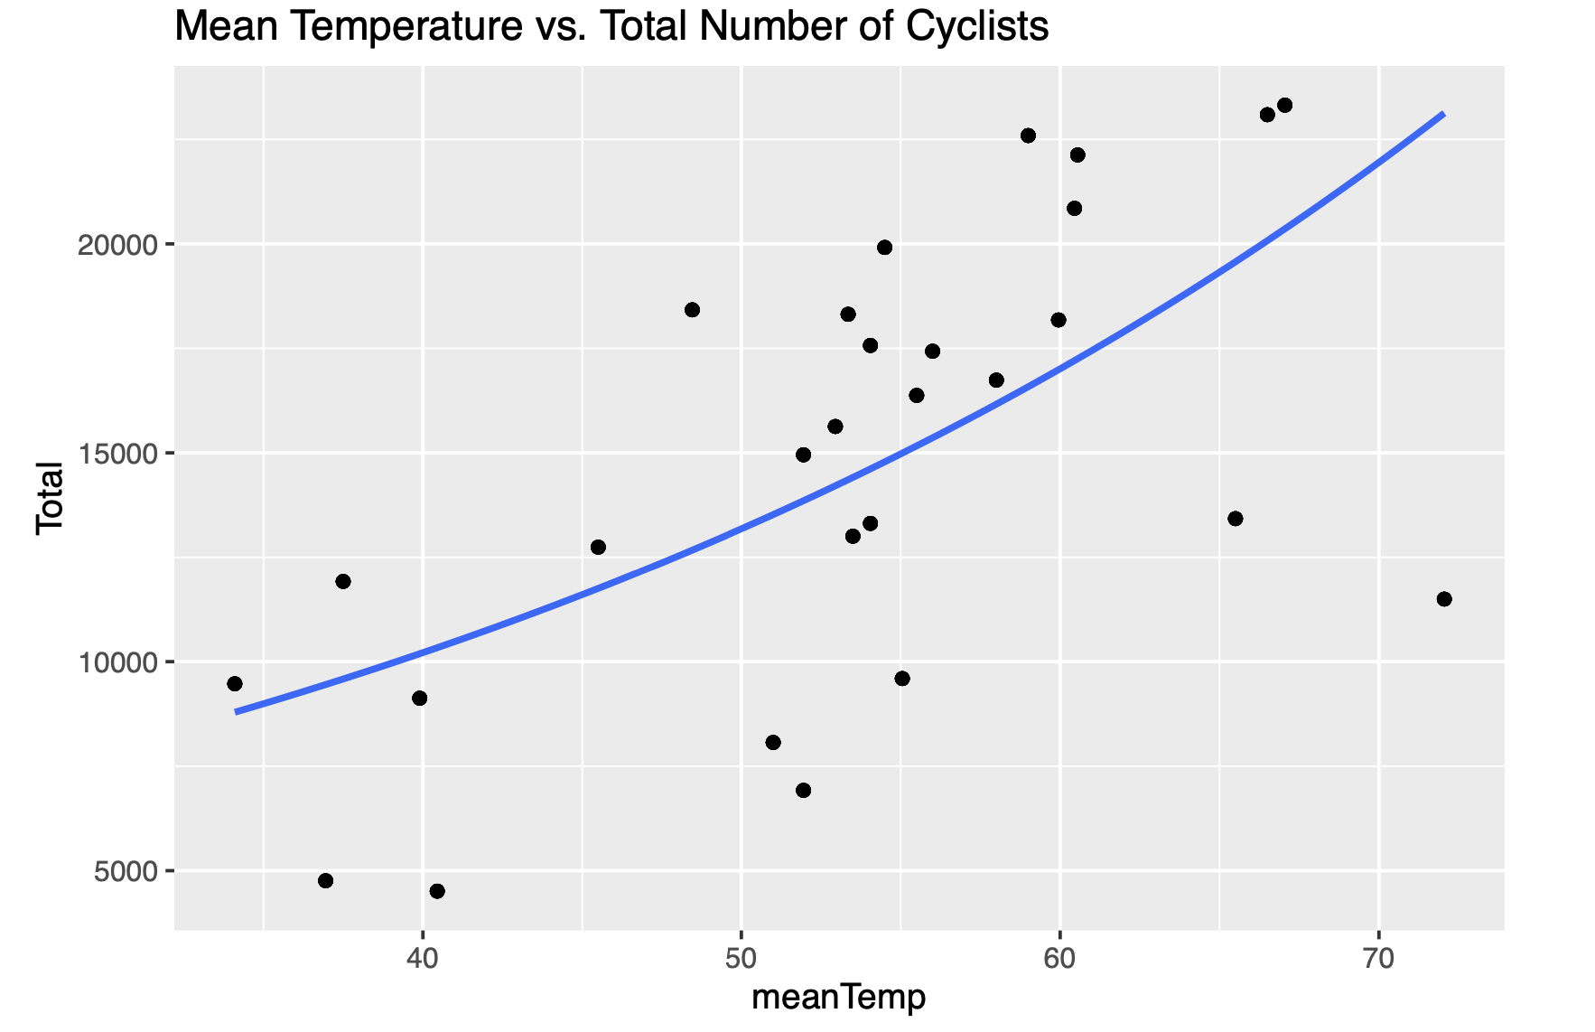
Data Exploration ( cont. )

Slide 6
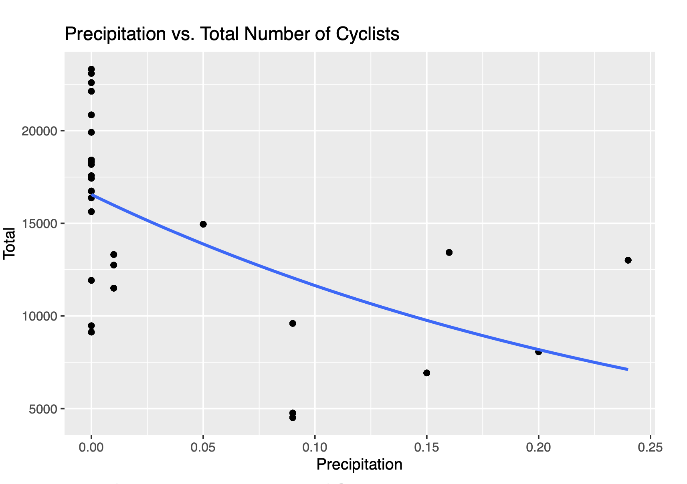
Data Exploration ( cont. )

Slide 7
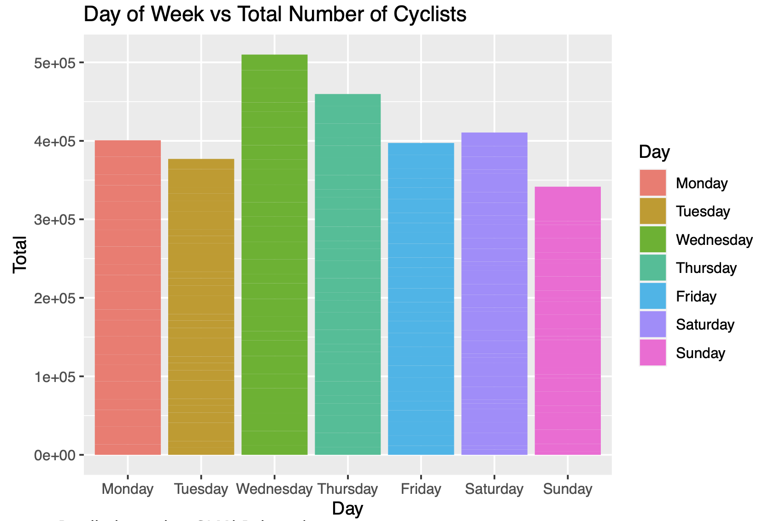
Data Exploration ( cont. )

Slide 8
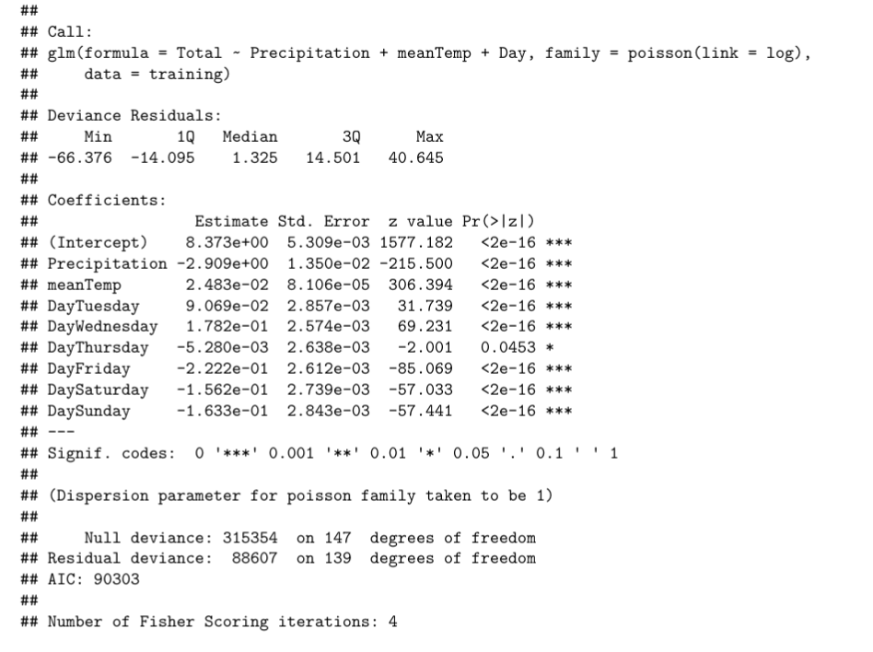
GLM (Poisson)

Slide 9
GLM (Poisson)
All predictors have a statistically significant coefficient.
The AIC is fairly high.
Strangely, the day of week is a better predictor of the number of cyclist than the temperature. This may be due to the limited dataset, it is restricted to the month of April in 2016.

Slide 10
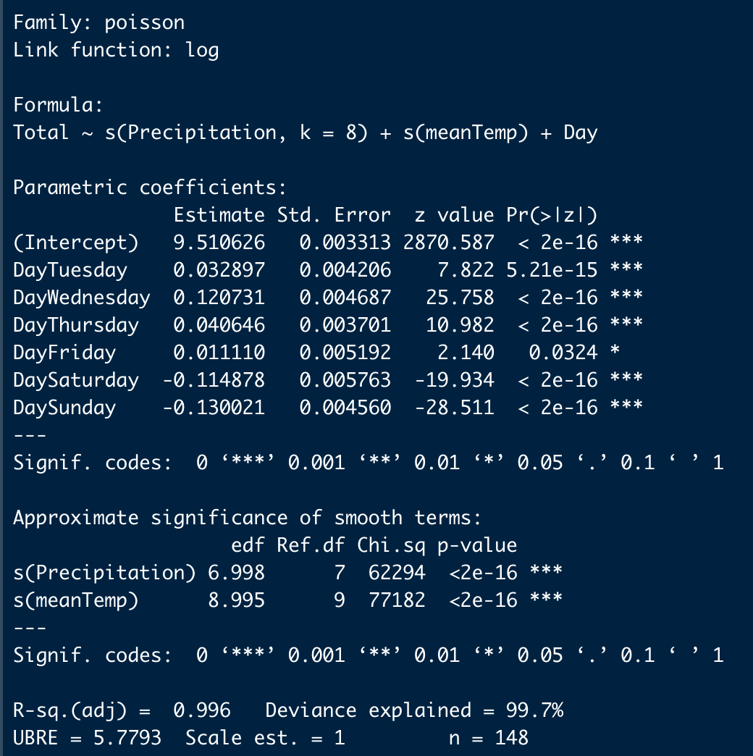
GAM

Slide 11
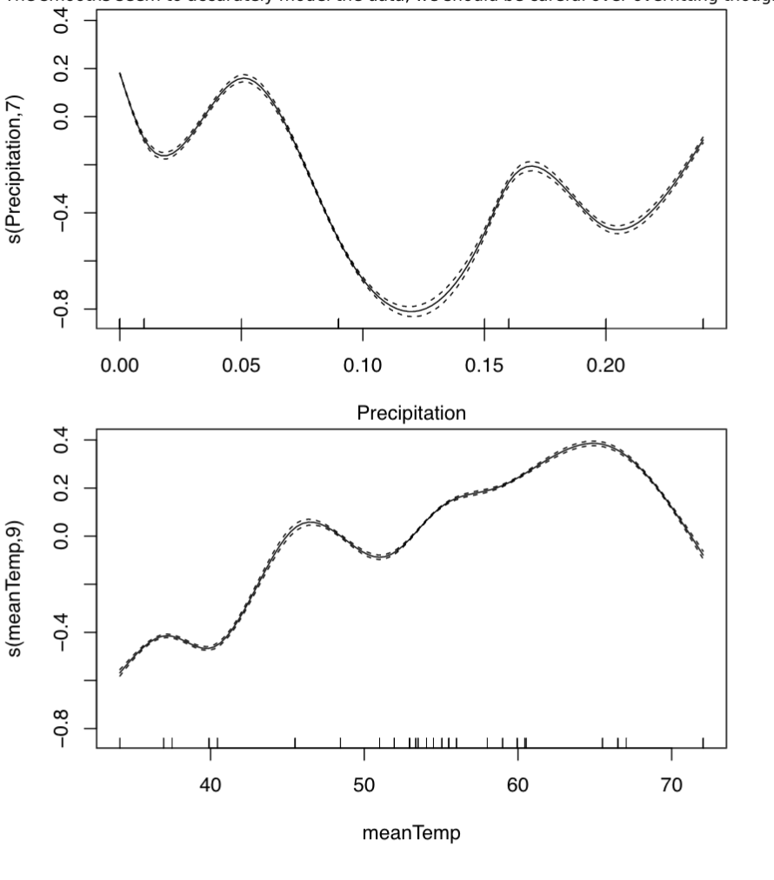
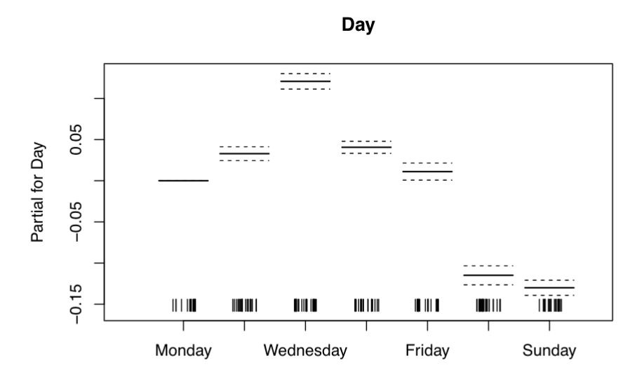
GAM
The adjusted R² is high, this may be a sign of an overfit model.
The smooth terms are statistically significant.

Slide 12
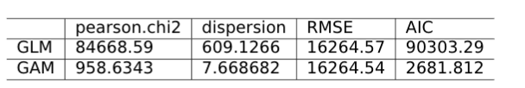
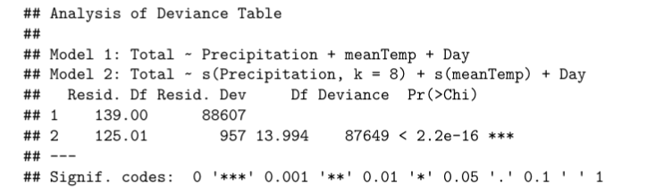
Model Comparison

Slide 13
Model Comparison
Using the anova function to compare these models shows that the gam model has a more parsimonious fit of the data.
The low p-value indicates that the second model is statistically significantly better at capturing the data than the linear model.
RMSE is lower for the GAM model and Pearsons χ² ,dispersion statistic, and AIC is lower.

Slide 14
Rootgram
The rootogram is a graphical tool associated with the work of J. W. Tukey that was originally used for assessing goodness of fit of univariate distributions. Here we extend the rootogram to regression models and show that this is particularly useful for diagnosing and treating issues such as overdispersion and/or excess zeros in count data models. -Kleiber
If a bar doesn’t reach the zero line then the model over predicts a particular count bin, and if the bar exceeds the zero line it under predicts.

Slide 15
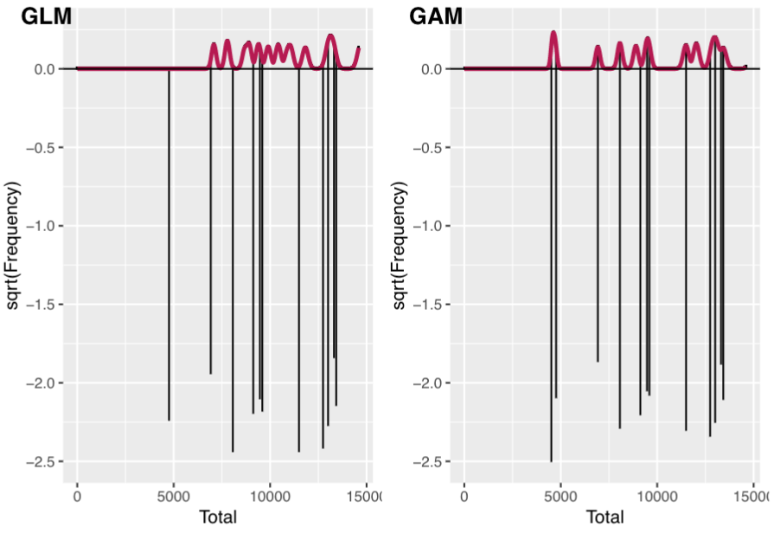
Rootgram
our models both under predicts the counts, however, the GAM does a better job at fitting the data

Slide 16
Conclusion
Limited size of the dataset, it has been confined to the Month of April. In order to get a better understanding of how the weather and day of week explains the number of cyclist, one should get a larger dataset from the NYC Dot and combine that with weather data.
The results from the General Additive Model are difficult to interpret. There is no single coefficient, that we can make inferences from (i.e. negative, positive, effect size etc.). One must carefully examine the plots of the smooths.
Precipitation has a highest influence on the number of cyclists.
The day of the week in general tends to be a stronger predictor than the temperature.

